Slide 1
Solution Manager 7.2
System Monitoring
(Setup & Configuration)
Trainer: Baldeep Singh

Slide 2
Introduction
Concept:
The System Monitoring application provides an overview of the current status of technical systems, including their associated instances, databases and hosts.
System Monitoring is based on automated checks in regular time intervals in the four categories Availability, Performance, Exceptions, and Configuration. In each of these categories, several metrics and corresponding thresholds can be defined per managed object.
The configuration is based on a template concept. Pre-defined templates can be used as a starting point to derive own customer specific templates.
In addition, alerts will be created and can be handled via the Alert Inbox in case thresholds are violated.

Slide 3
Introduction
System Monitoring provides the following features:
Status overview regarding technical system including instances, databases and hosts.
Visualization of metrics and events with their current rating and last reported values
Drill down capabilities from status information on technical system to single metrics
Visualize metrics and events including thresholds and current rating/value
Jump-in capability into metric monitor to display historical metric values including interactive selection of the timeframe to be displayed

Slide 4
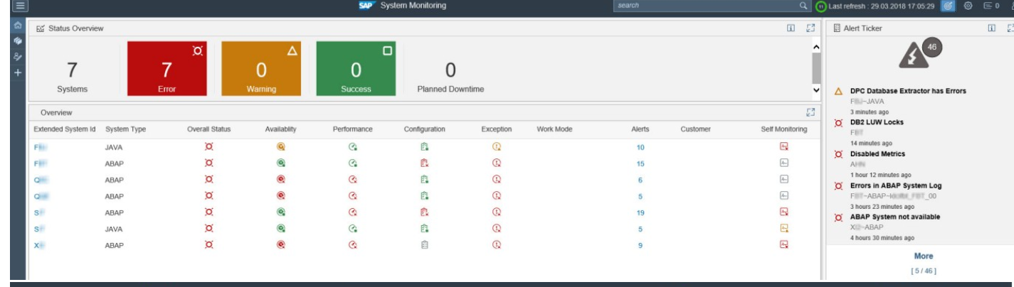
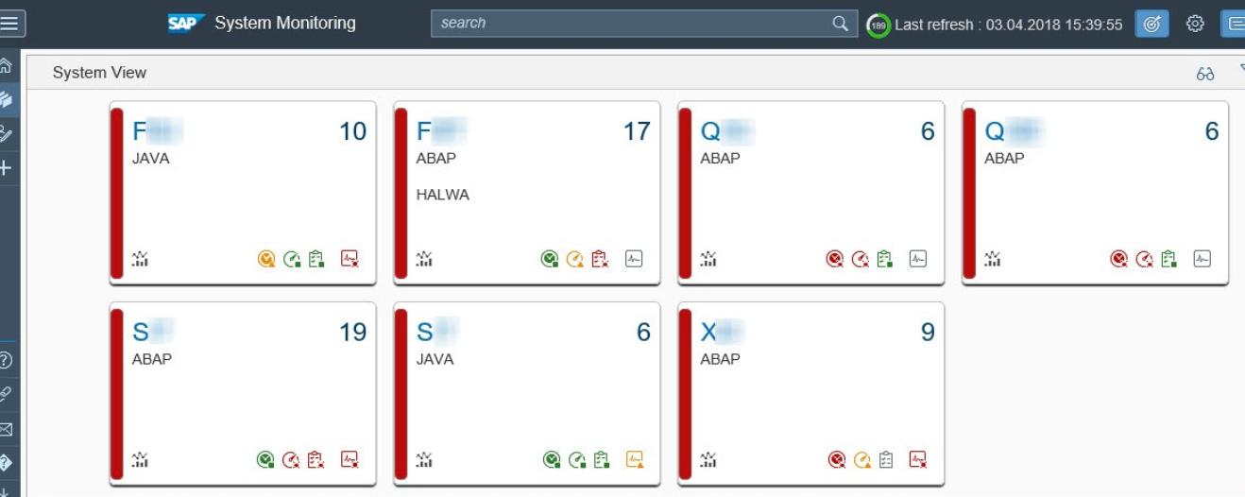
Introduction
This application is now based on SAPUI5 technology. The user interface has been enhanced considerably compared to the previous version in SAP Solution Manager 7.1 and is now harmonized with the other monitoring functionalities.

Slide 5
Main Use Cases & Benefits
System Monitoring allows to detect issues early and prevent major disruptions by proactively monitoring the general health of the IT landscape. The goals addressed by System Monitoring include:
Transparency: visibility of the overall health of the landscape
Proactive monitoring: detect upcoming problems before they become critical for the business
Single Source of truth: collects alerts from all systems in your landscapes in one central place
Benefits:
Mass-configuration via templates
Seamless integration with Alert Inbox and reporting/dashboard capabilities
Landscape awareness: relationships between managed objects belonging to the same technical system are taken into account
Integrated Self-Monitoring capabilities to detect issues with collection and processing of monitoring data
Integration with Work Mode Management and IT Calendar

Slide 6
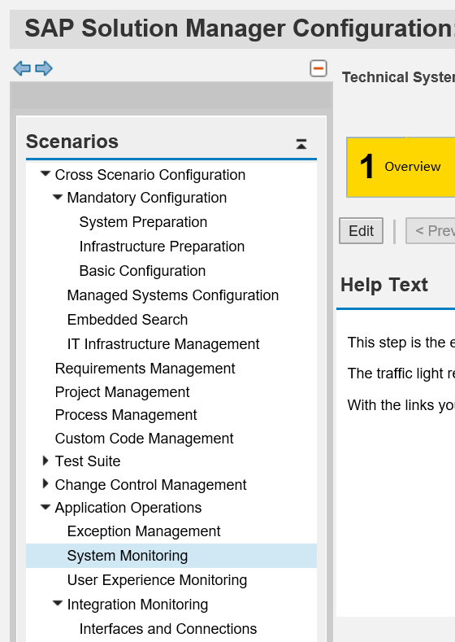
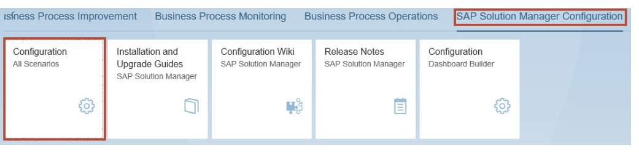
System Monitoring Setup
To configure System Monitoring starting from the SAP Fiori Launchpad of SAP Solution Manager, navigate to the tile group SAP Solution Manager Configuration and open the tile Configuration (All Scenarios). Alternatively, run the transaction SOLMAN_SETUP.
<<----- Solman_Setup
SM_WORKCENTER

Slide 7
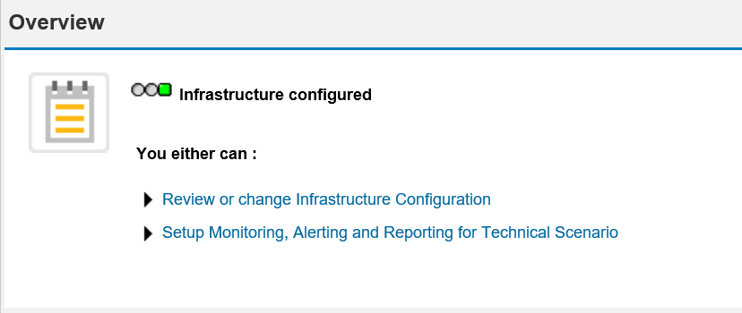
System Monitoring Setup
Step 1: Overview
This step is the entry point and overview page of the system monitoring configuration. System Monitoring includes technical systems, DBMS and hosts.
The traffic light reflects the current configuration status of the monitoring infrastructure.

Slide 8
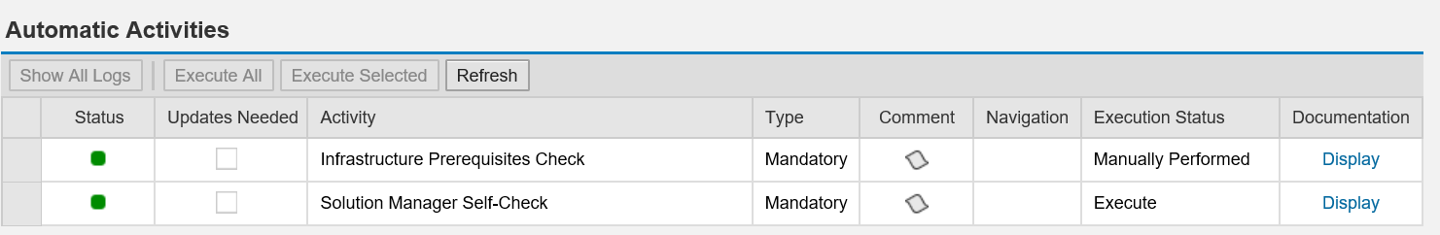
System Monitoring Setup
Step 2: Configure Infrastructure
In the sub-steps of step 2, you configure the monitoring infrastructure, including important global settings for alerting, housekeeping etc.
Step 2.1: Check Prerequisites
In this step, you use the automatic activities to check the prerequisites for the configuration of the System & Application Monitoring infrastructure.

Slide 9
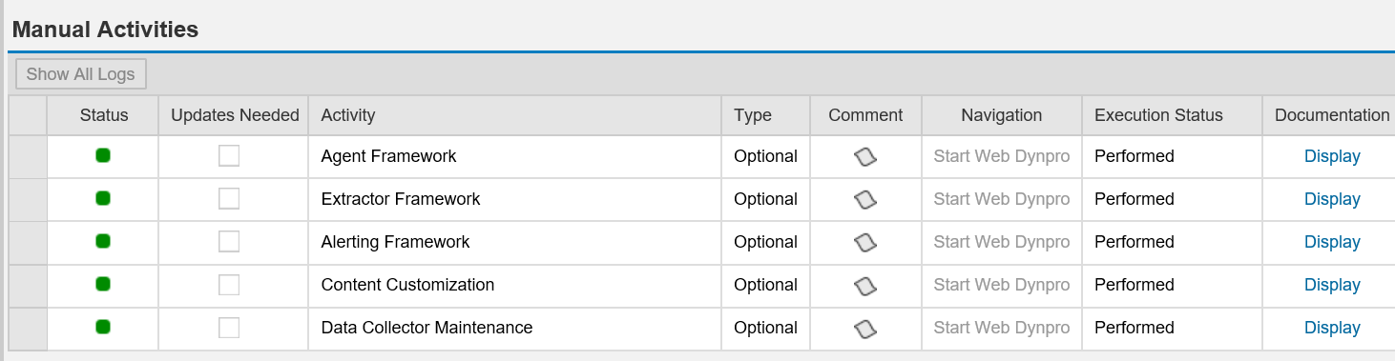
System Monitoring Setup
Step 2.2: Configure Manually
In this step, you perform manual activities to configure the System and Application Monitoring infrastructure.

Slide 10
System Monitoring Setup
  Step 2.3: Default Settings
  In this step you can enable or disable certain functions for the System & Application Monitoring on a global level (i.e. these settings affect all alerts from System Monitoring). It is possible to overwrite these settings on the level of templates as well as alerts.
    Automatic Incident Creation
    Automatic Notification
    Automatic Alert Confirmation

Slide 11
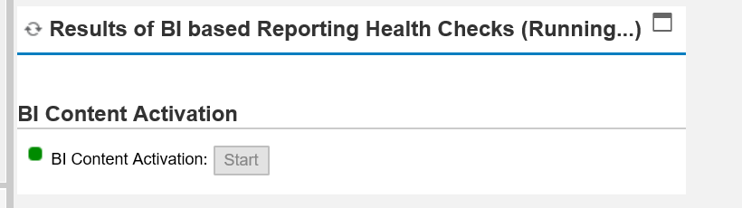
System Monitoring Setup
  Step 2.4: Reporting Setting
    In this step, the health check results of the BI-based reporting are displayed, so you can see whether the preconditions for successfully activating the BI-based reporting are met.
    Activities
    Make sure that object changes are allowed both for the BW client and the software component Local Developments (LOCAL). This is done in SE06.
    Activate the BW content : Clicking Start Button.

Slide 12
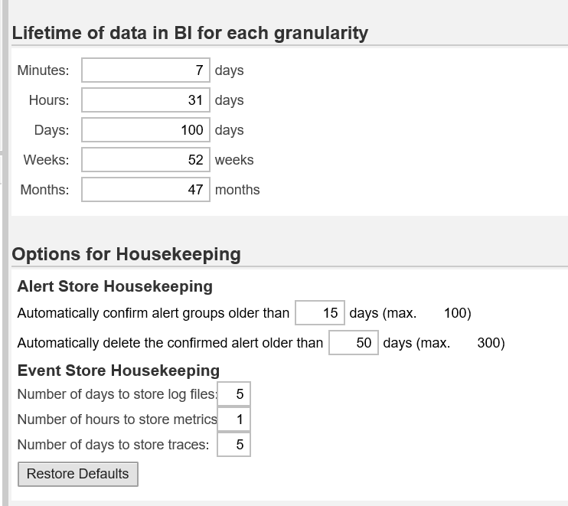
System Monitoring Setup
  Step 2.5: Housekeeping
    In this step, you can specify the lifetimes of the metrics in the BI, and the data in the Alert/Event Store.

Slide 13
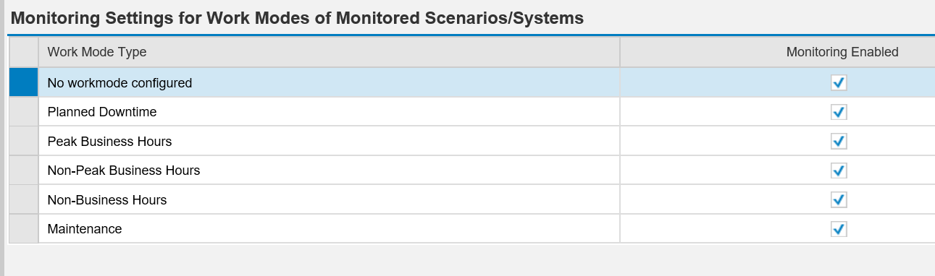
System Monitoring Setup
Step 2.6: Workmode Settings:
  In this step, you configure the standard behavior of the monitoring use case, depending on the work mode. The settings affect all metrics and alerts of the monitoring use case. The work mode depends on the monitoring use cases.

Slide 14
System Monitoring Setup
  Step 2.7: Update Content:
  A content version contains SAP monitoring content for all System and Application Monitoring scenarios.
  Improvements of content for your current support pack may become available over time, so always use the latest available content by updating your content whenever newer content is available.

Slide 15
System Monitoring Setup
Step 3: Standard Users
In this optional step, you can create standard users in the SAP Solution Manager system.
You have the following options:
Create New User : The system creates the new user and the corresponding business partner, if necessary, and assigns the relevant copied and SAP roles.
Provide Existing User: If you update an existing user, the system assigns the relevant copied roles and SAP roles to an existing user. If you have selected Accept Manually Created User Without Checking Roles Assignment, roles are not assigned to the mentioned user.
Update User Roles: The system assigns the relevant copied and SAP roles to the selected current user ID.
Update Password: You assign a new password to the selected current user ID.

Slide 16
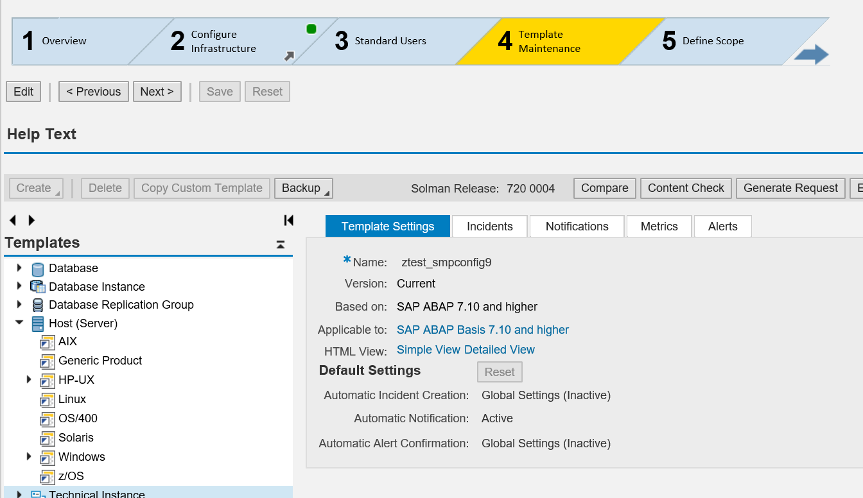
System Monitoring Setup
Step 4: Template Maintenance
A managed object (MO) is an entity in the system landscape of a customer; you can see the MO types available for this monitoring use case in the Configuration Explorer displayed below. For every MO type SAP provides templates that contain the definitions or values of metrics, events, and alerts (MEA) of incidents and notifications.

Slide 17
System Monitoring Setup
Step 5: Define Scope
In this step you select the managed object you want to configure for system monitoring. Without selecting a managed object you cannot proceed to the next setup steps.
Please note that selecting a managed object and configuring monitoring (in step 6) creates a so-called entry point. If you select a technical system in step 5, a corresponding entry point will be created for this technical system, and System Monitoring will be activated for all associated managed objects (including technical instances, database and hosts). This allows you to remove monitoring for the whole entry point in one go, if required.

Slide 18
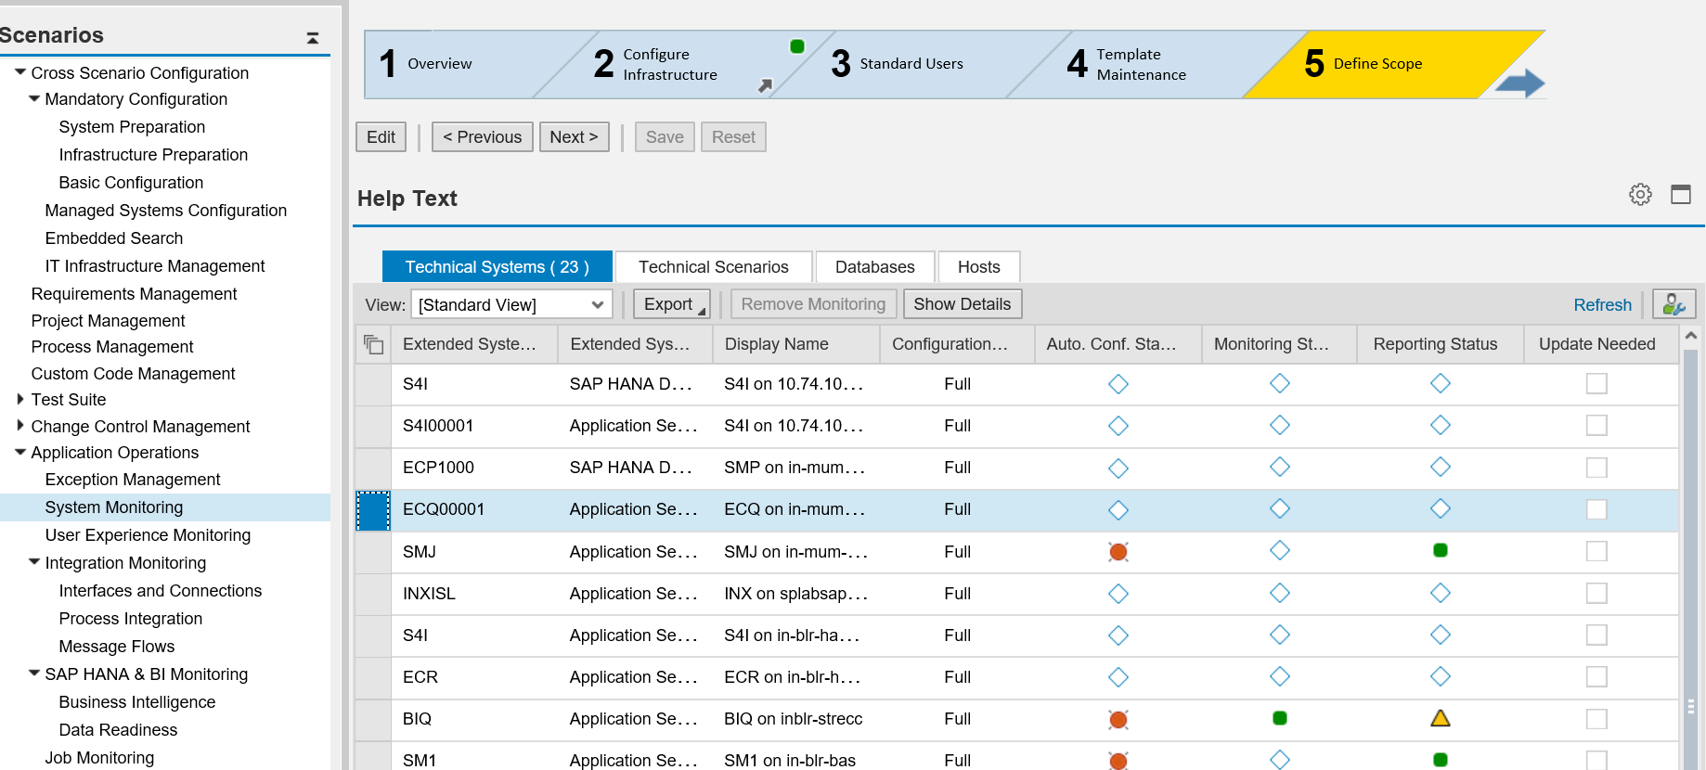
System Monitoring Setup

Slide 19
System Monitoring Setup
Step 6: Setup Monitoring
In this step monitoring templates will be assigned to the managed systems in scope.
Each technical system is associated with several managed objects (e.g. technical instances, database(s), database instances, database replication group, hosts), which logically form a hierarchy below the technical system level. This hierarchy is pulled from the LMDB and displayed in step 6.
Based on the information about installed products as maintained in the LMDB, default templates are automatically assigned to the different managed objects. The current assignment can be seen in the column Assigned Templates. The assignments can be changed per managed object and per product via Assign Templates.

Slide 20
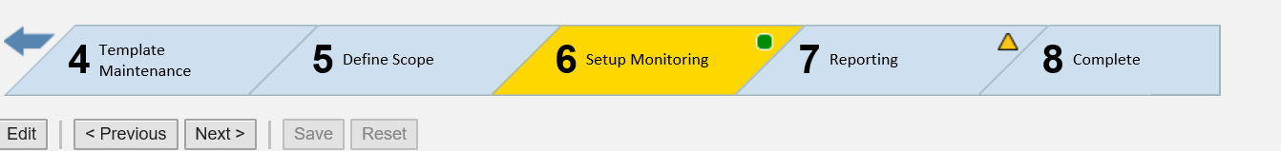
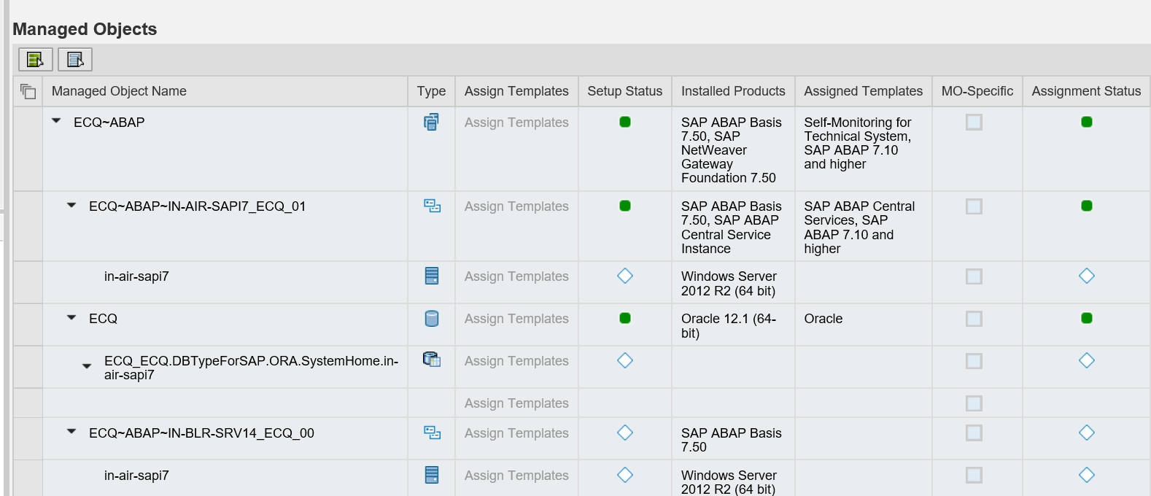
System Monitoring Setup
After verifying the correct assignment of templates, click Apply and Activate to write the monitoring configuration to the directory tables and activate monitoring

Slide 21
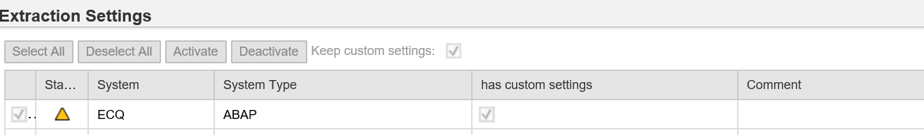
System Monitoring Setup
Step 7: Reporting
In this step, you specify from which managed systems metrics are collected in BW for interactive reporting. To collect metrics from a managed system, select the corresponding indicator in the first column of the table Extraction Settings and choose Activate.

Slide 22
System Monitoring Setup
The Status tells you whether metrics have been collected for the system. It can take the following values:
Green (Reporting active). All required reporting data has been collected for the system. You do not need to activate collection.
Gray (Reporting inactive). No reporting data has been collected for the system. Activate data collection if you want to display the data of the system in interactive reporting.
Yellow (For complete activation, activate without keeping custom settings). The system has individual settings, i.e. you have made settings at metric level in the interactive reporting Scenario Setup settings, e.g. to restrict the data collection scope, or to collect particular metrics for user reports.

